Slide 1

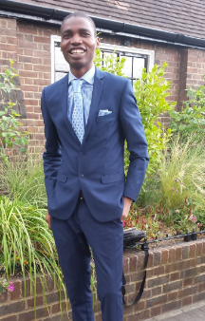
Automated Mind
Digital Solutions Consultant
Michael Oshaye
2020

Slide 2


Summary skills
Collaboration
Experienced, motivated and versatile IT professional
Delivering and implementing IT solutions on different customer challenges
(Windows and Linux )
(Oracle and SQL )
(AWS, Azure and On Premise)
(Devops and PM)

Slide 3


Achievements
Award Winning Projects
CHC EMEA Regional Director Recognition Award - May 2017- Home Safely
Migration of more than 3 customers from On- Premise QHSE Software to Azure SAAS Synergi Life software

Slide 4
My Goals
Customer Centric, Communication & Collaboration
Digital Innovation & Devops Automation Culture
Continuous Improvement, Customer Driven & Consultancy
Training and Mentorship

Slide 5

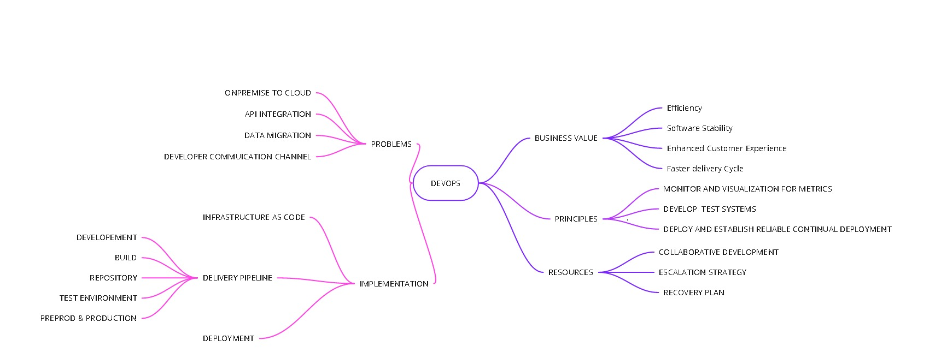
DevMind

Slide 6
Future Challenges Post COVID-19
Cyber security
Latency and auto scaling management
API integration as more business migrate to cloud

Slide 7

Thank you!
Michael Oshaye
Phone
+44 7914313870
Email
oshaye3@yahoo.com

